Slide 1
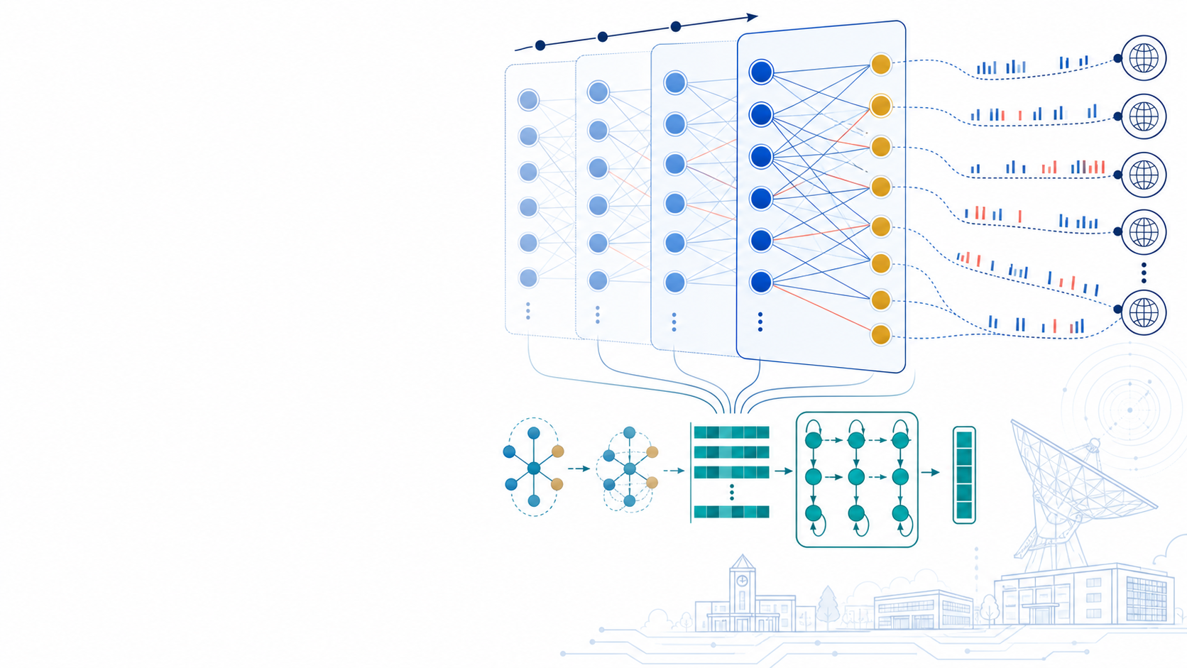

APNet 2026
EAGLE
Erroneous Traffic Analysis
with Graph Representation Learning
Xiaoxiong Yang · Zhihao Wang · Dingde Jiang
Turning failed contacts into behavioral evidence
University of Electronic Science and
Technology of China

Slide 2
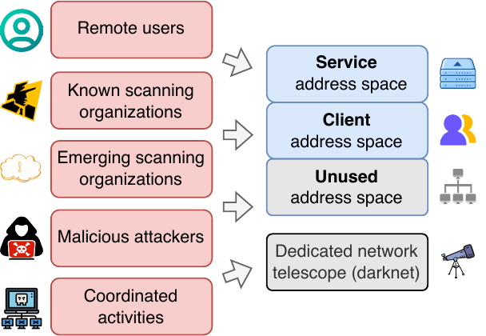
MOTIVATION
Erroneous traffic is signal—not noise
Failed contacts expose activity that successful-flow monitoring can miss.
1
Scanning & attacks
Masscan, ZMap, Mirai and other campaigns leave failed-contact signatures.
2
Failures & misconfiguration
Broken services and routing mistakes surface before users report them.
3
Passive observation
No probing is required: the network already produces the evidence.
Question: How can we systematically analyze large-scale erroneous traffic?
2

Slide 3
CURRENT LIMITATIONS
Existing models miss one or more essential signals
Erroneous traffic is relational, temporal, open-world—and sparsely labeled.
01
Handcrafted statistics
02
Sequence embeddings
03
Temporal graph models
Rules and engineered aggregates target known patterns. Behavior shifts require manual redesign.
Co-occurrence is useful, but sender–destination topology is flattened. New senders require embedding updates.
Topology and time are often modeled at coarse granularity, limiting tracking of rapidly evolving campaigns.
[IMC'19] [USENIX Security'22]
[CoNEXT'21] [TOIT'23]
[GNNet'23]
Design target
Relational + Temporal + Inductive + Self-supervised
3

Slide 4
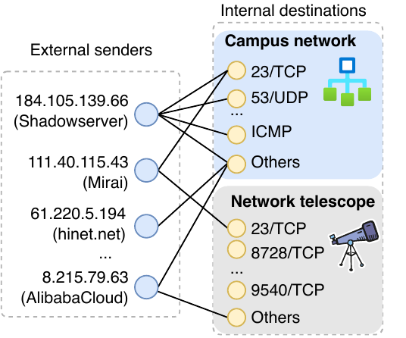
REPRESENTATION
Packets become dynamic bipartite graphs
1
External senders
One node for each source IP observed in a six-hour window.
2
Internal destinations
Protocol + port + subnet define destination-service nodes.
3
Attributed nodes
Traffic statistics summarize every sender–destination interaction.
4

Slide 5
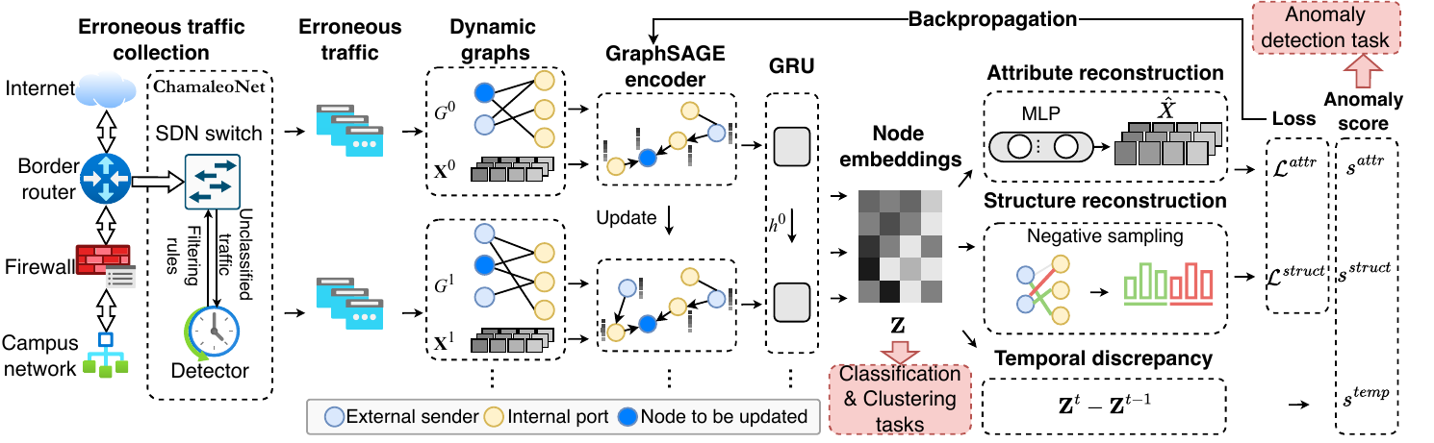
METHOD
EAGLE encodes structure, updates over time, and trains self-supervised
1 GraphSAGE
2 GRU
3 Self-supervision
Aggregates two-hop neighborhood evidence.
Carries campaign history across snapshots.
Reconstructs attributes and structure—no dense labels.
5

Slide 6
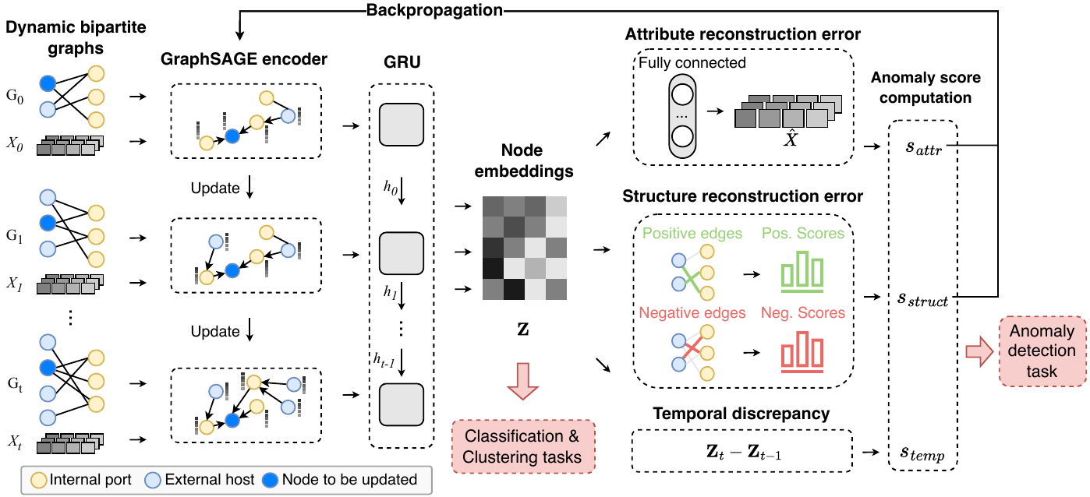
UNIFIED FRAMEWORK
One embedding supports various downstream analyses
Anomaly detection
Detect newly emerging sender behavior
Classification
Recognize known scanner families
Clustering
Discover coordinated unknown groups
6

Slide 7
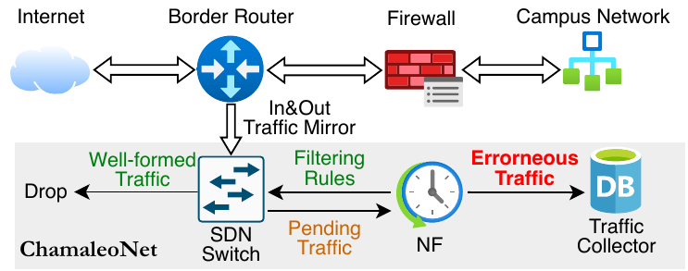
DATASET & PROTOCOL
Real-world erroneous traffic dataset from a /16 campus network
431M
155,622
erroneous packets per day
unique external senders
≈32K
≈694K
nodes per snapshot
edges per snapshot
7 days
28 snapshots
24 train
4 test
38 features
Feb 22–28, 2025
6-hour granularity
first six days
final day
traffic statistics
7

Slide 8
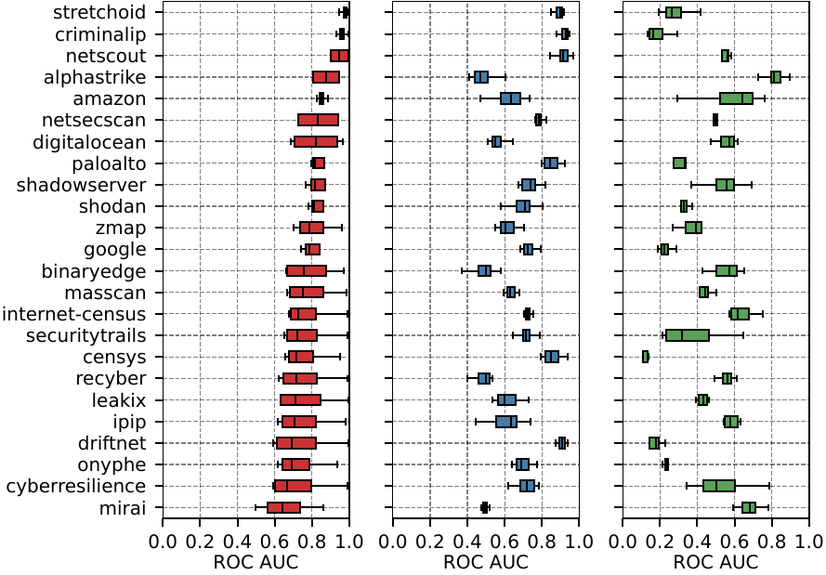
RESULT 1
Temporal context lifts anomaly detection
ROC AUC
0.809
EAGLE
0.696
best static GNN
0.427
best classical ML
Takeaway
Temporal graph representations detect emerging scanner behaviors more reliably.
8

Slide 9
RESULT 2
The same embeddings separate scanner families
+17.2%
0.913
Macro F1
relative Macro-F1
improvement
0.779
0.977
26 classes · 86K senders
Weighted F1
0.911
0.7
0.8
0.9
1.0
More discriminative sender embeddings
EAGLE
i-DarkVec
9

Slide 10
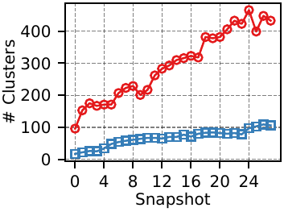
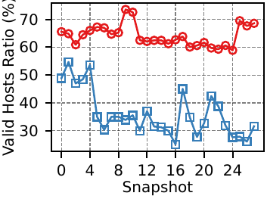
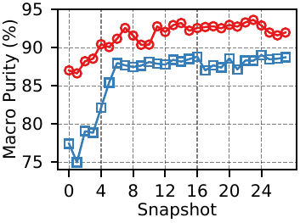
RESULT 3
EAGLE consistently outperforms i-DarkVec in clustering
EAGLE
i-DarkVec
100→400+ vs <100
64.1% vs 36.0%
86–93% vs 75–89%
valid clusters over time
average valid-host coverage
macro purity range
EAGLE covers 78.1% more valid senders while maintaining higher purity.
10

Slide 11
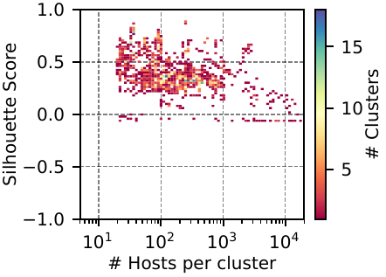
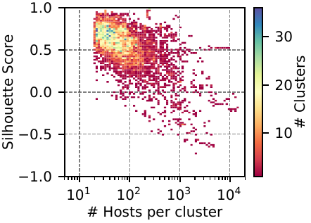
RESULT 4
EAGLE forms smaller, more compact clusters
Silhouette score versus cluster size
i-DarkVec
EAGLE
Larger, coarser groups
with lower silhouette scores
Mostly 10–200 senders
with silhouette scores of 0.5–1.0
11

Slide 12
CASE STUDIES
Cluster inspection reveals coordinated campaigns
1,062 clusters · 121K senders · 28 snapshots
CASE 1
CASE 2
Mirai variants
Alibaba Cloud crawlers
23/TCP
80 · 8080 · 9090
Compact clusters share stable packet features and coordinated probing of tens of thousands of internal addresses. Many include previously unlabeled senders.
Unknown senders probe thousands of campus addresses with tens of thousands of TCP SYNs. Reverse DNS and synchronized phases indicate coordinated web crawling.
Behavioral clusters turn anonymous traffic into actionable hypotheses.
12

Slide 13
TAKEAWAYS
Graph representation learning unlocks the value of erroneous traffic.
01
Relational
Bipartite graphs preserve shared targets and coordinated behavior.
02
Temporal
GraphSAGE + GRU captures campaign evolution across snapshots.
03
Label-efficient
Self-supervision yields reusable embeddings for three downstream tasks.
Questions?
EAGLE · APNet 2026

